Slide 1
Introductory General Chemistry
Chemistry 3A
Experiment 10a
Types of Reactions
Mitch Halloran

Slide 2
Introduction
There are countless chemical reactions that can occur
But reactions fall within certain types, certain categories
This experiment is about studying one of each reaction that falls within a certain type or category

Slide 3
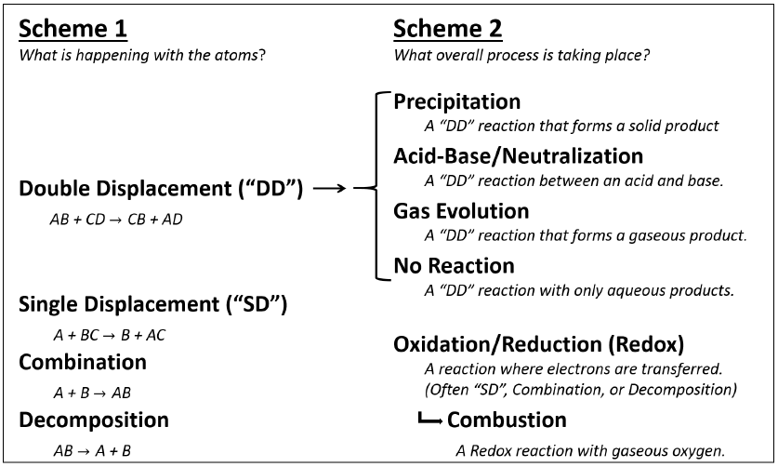
Background
With the types/categories of reactions, two “schemes” emerge
Scheme 1 is “what happens with atoms?” Scheme 2 is about process

Slide 4
Background
With the types/categories of reactions, two “schemes” emerge
Scheme 1 is “what happens with atoms?” Scheme 2 is about process

Slide 5
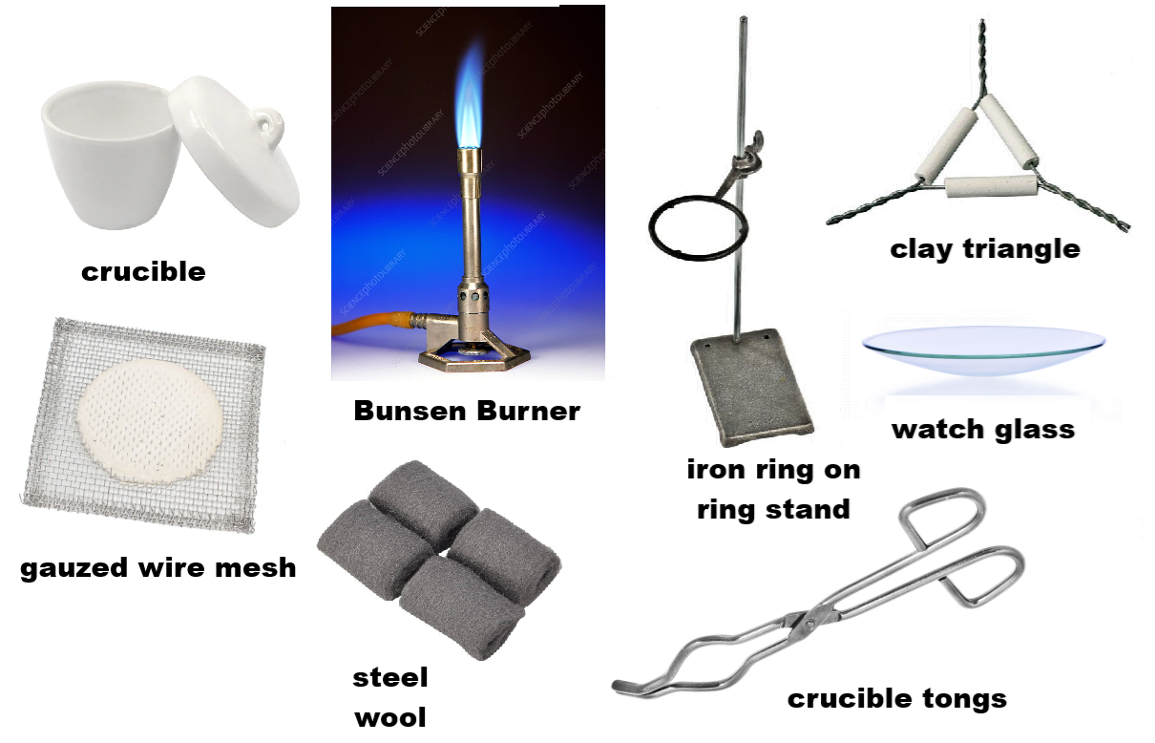
Equipment You Will Use

Slide 6
Procedure
Cleaning the Crucible
If crucible dirty, use small steel wool piece to scrape out solids. Wipe with dry paper towel
Put crucible on stand and heat with blue-coned flame until slightly red hot
Use tongs to set crucible on wire mesh and let cool to room temperature (~5 minutes)
DO NOT SET ANY HOT CRUCIBLE ON COUNTERTOP OR ON PAPER OR THEY CAN BURN!

Slide 7
Procedure
Before Reaction
Determine mass of empty crucible (A)
Get copper wire, coil it to fit in crucible. Record the physical properties, and then the mass of the wire in crucible (B)
On glassine paper, use scoopula to get 2-4 g sulfur. Add to the crucible to cover the coiled wire. Record total mass in crucible (C)

Slide 8
Procedure
Reaction
Heat the contents with a blue flame of the Bunsen burner. The sulfur will melt within about a minute.
Use the crucible tongs to transfer the crucible to the wire mesh. The melted sulfur reacts with the copper during this time.
Put the crucible back on the flame: the unreacted sulfur will burn off, forming sulfur dioxide (SO₂) gas, vented in the hood. The crucible looks clean and dry except for the coil of copper sulfide.
Set the crucible again on the wire mesh to cool
Record mass of crucible with the new compound (D)
Carefully tip crucible contents on to watch glass and make observations of physical properties

Slide 9
Example Data Analysis
Suppose A=23.7584 g, B=34.3532 g, C=37.5732 g. After the reaction, D=36.7841 g
[B-A]=10.5948 g, [C-B]=3.2200 g, [D-A]=13.0257 g
Copper reacted should be same as initial copper, because copper doesn’t go anywhere
Sulfur reacted should be [D-A]-[B-A]=13.0257 g - 10.5948 g= 2.4309 g
Excess sulfur = [C-B]-2.4309 g = 3.2200 g – 2.4309 g =0.7891 g
Mass ratio = copper/sulfur reacted = 10.5948 g/2.4309 g = 4.3583

Slide 10

Example Data Analysis
What does the mass ratio show?
For every 1 g of S, there are about 4.4 g Cu
Look at the molar masses of S and Cu.
If there are 32.065 g/mol S and 63.546 g/mol Cu, and there are 2 mol Cu and 1 mol S in Cu₂S, then what is the theoretical mass ratio of S to Cu in Cu₂S?
$$\frac{\frac{\text{63.546 }\text{g} \text{Cu}}{\text{mol} \text{Cu}}\text{×}\text{2 }\text{mol} \text{Cu}}{\frac{\text{32.065 }\text{g} \text{S}}{\text{mol} \text{S}}\text{×}\text{1 }\text{mol} \text{S}}=\frac{\text{3.9636 }\text{g} \text{Cu}}{\text{1 }\text{g} \text{S}}$$
4.4 g Cu/g S seems close to 4.0 g Cu/g S. How close can you get?

Slide 11
Clean Up
The copper sulfide product goes into solids waste container
WITHOUT AT ALL GETTING CRUCIBLE WET WITH ANY WATER, wipe crucible with dry paper towel
Use soapy water to clean the watch glass
Place all other items in appropriate locations

